Slide 1
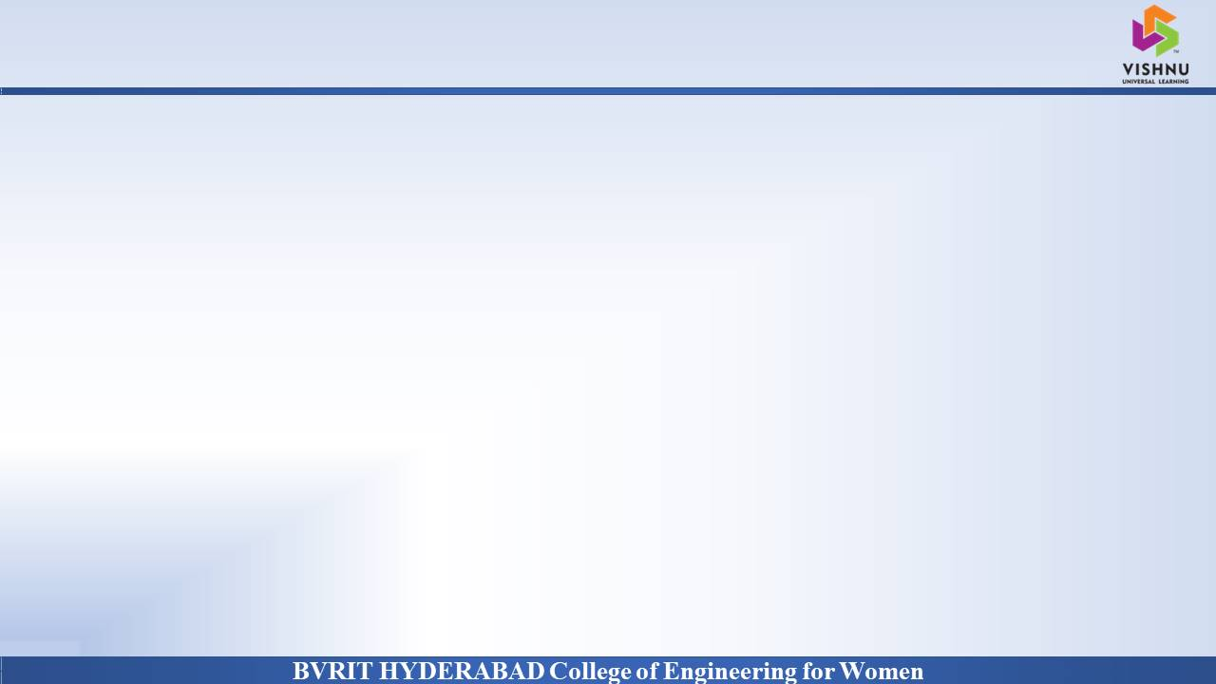
Department of Computer Science and Engineering
SCHOOL MANAGEMENT SYSTEM
Date: 27 May 2021
K. Siri Satwika : 17WH1A05B3
A. Sri Nithya : 17WH1A0578
S. Saharsha : 17WH1A0572
Internal Guide : Ms. Suparna Das
Designation : Assistant Professor

Slide 2

Abstract
Why Should I Study this course?
Education plays a great role in the development of any country. Many education organizations try to increase education quality. One of the aspects of this improvement is managing school resources.
This project contains the admin, teacher, parent and student side. Admin can manage students, teachers, classes, subjects, academic calendars. Teachers role is to mark attendance, upload the marks, worksheets, teaching content and give feedback of students to their parents. Student role is to view their marks, attendance, view teaching content, academic calendar. Parent role is to view their child performance, give feedback about the school.
Examples
BVRIT HYDERABAD College of Engineering for Women

Slide 3
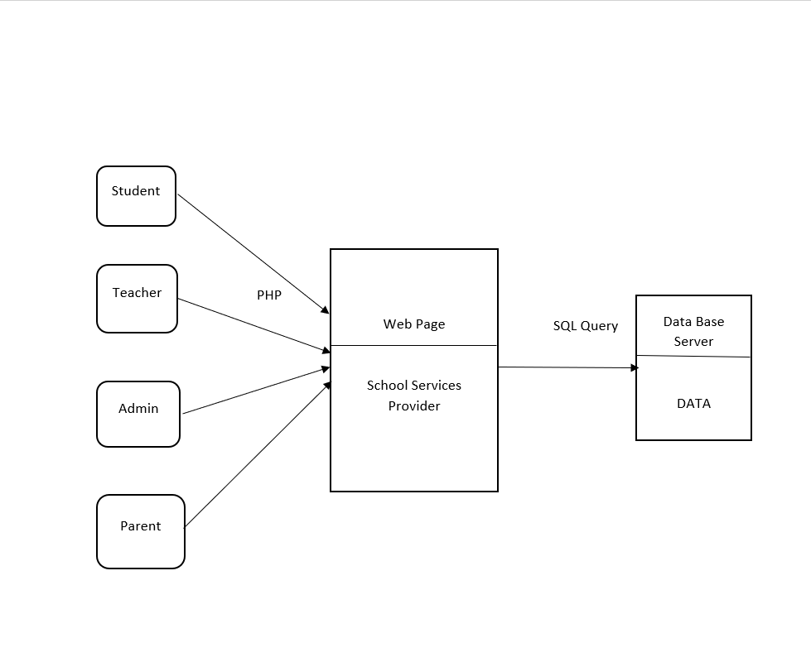
Architecture Diagram
Why Should I Study this course?
Examples
BVRIT HYDERABAD College of Engineering for Women

Slide 4
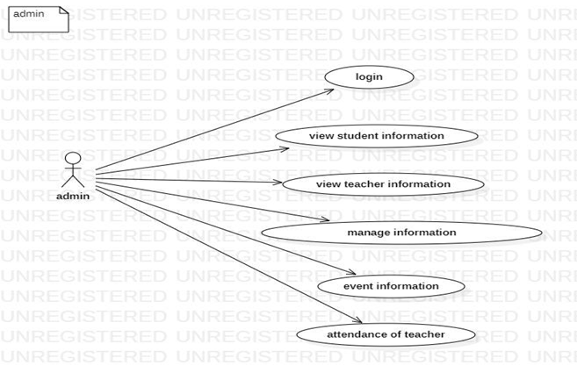
Usecase Diagram of Admin
Why Should I Study this course?
Examples
BVRIT HYDERABAD College of Engineering for Women

Slide 5
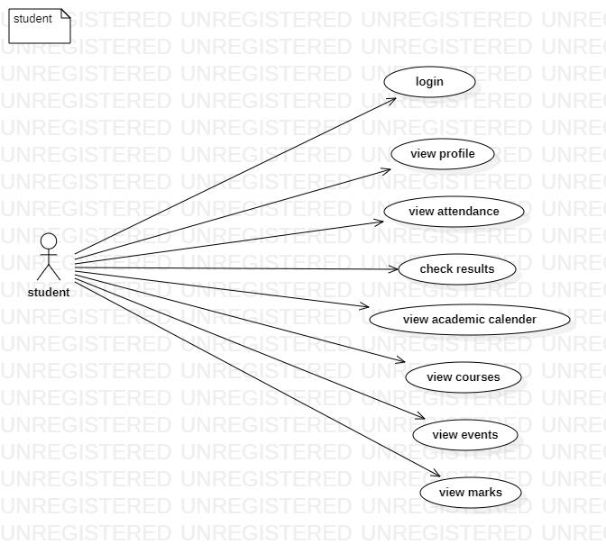
Usecase Diagram of Student
Why Should I Study this course?
Examples
BVRIT HYDERABAD College of Engineering for Women

Slide 6
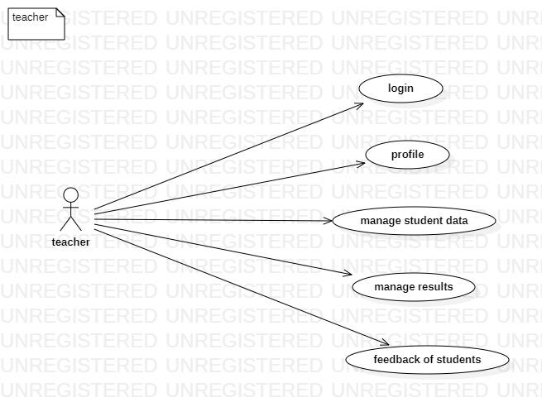
Usecase Diagram of Teacher
Why Should I Study this course?
Examples
BVRIT HYDERABAD College of Engineering for Women

Slide 7
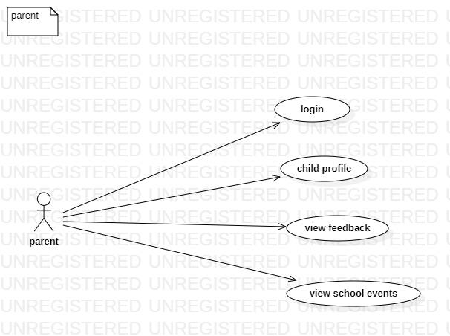
Usecase Diagram of Parent
Why Should I Study this course?
Examples
BVRIT HYDERABAD College of Engineering for Women

Slide 8
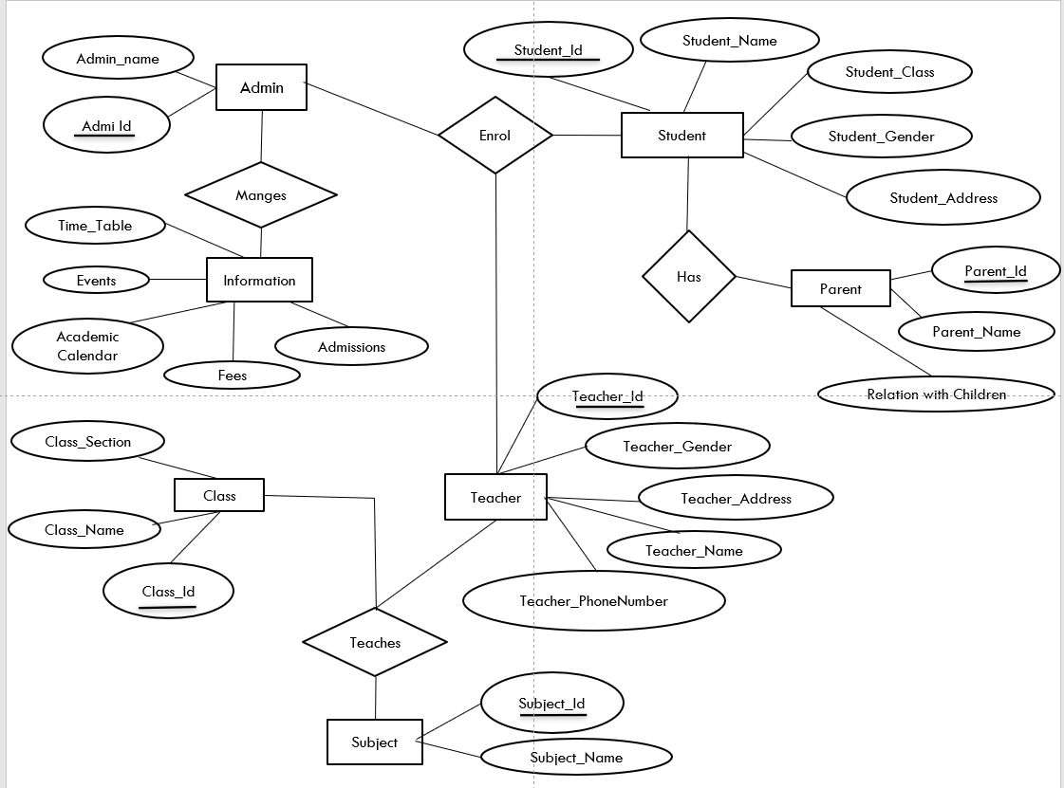
E-R DIAGRAM
Why Should I Study this course?
Examples
BVRIT HYDERABAD College of Engineering for Women

Slide 9
Testing
Test Case no | Test Scenario | Expected Result | Actual Result | Out put
TCO1 | Check whether the home page is working. | O/p as expected | as expected | pass
TCO2 | Check whether all logins are valid. | Login is validated | as expected | pass
TCO3 | check whether admin is able to handle all features. | able to handle like add, edit, view and delete. | as expected | pass
TCO4 | Check whether teacher is able to handle all features like add study material, give attendance, enter marks. | able to upload the mentioned features. | as expected | pass
TCO5 | Check whether student is able to handle all features like view study material, check attendance. events etc. | able to view the mentioned features. | as expected | pass
TCO6 | Check whether parent is able to handle all features like view their child’s performance. | able to view the mentioned features. | as expected | pass
TCO7 | Check whether the excepted output is achieved | O/p as expected | as expected | pass
Why Should I Study this course?
Examples
BVRIT HYDERABAD College of Engineering for Women

Slide 10
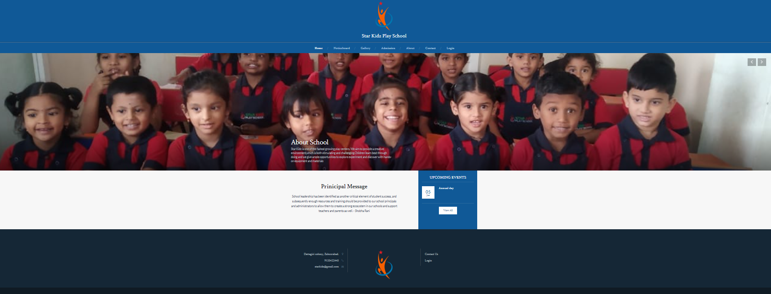
Output
Why Should I Study this course?
Examples
BVRIT HYDERABAD College of Engineering for Women

Slide 11
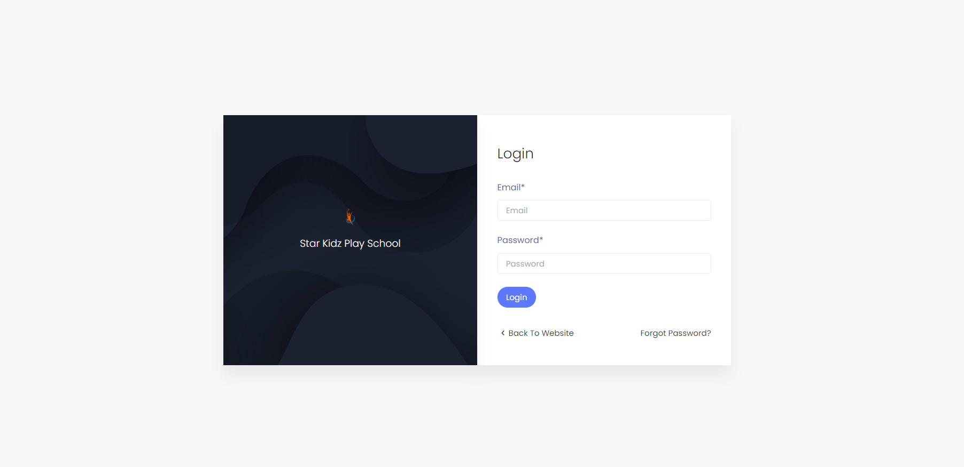
Output for login page
Why Should I Study this course?
Examples
BVRIT HYDERABAD College of Engineering for Women

Slide 12
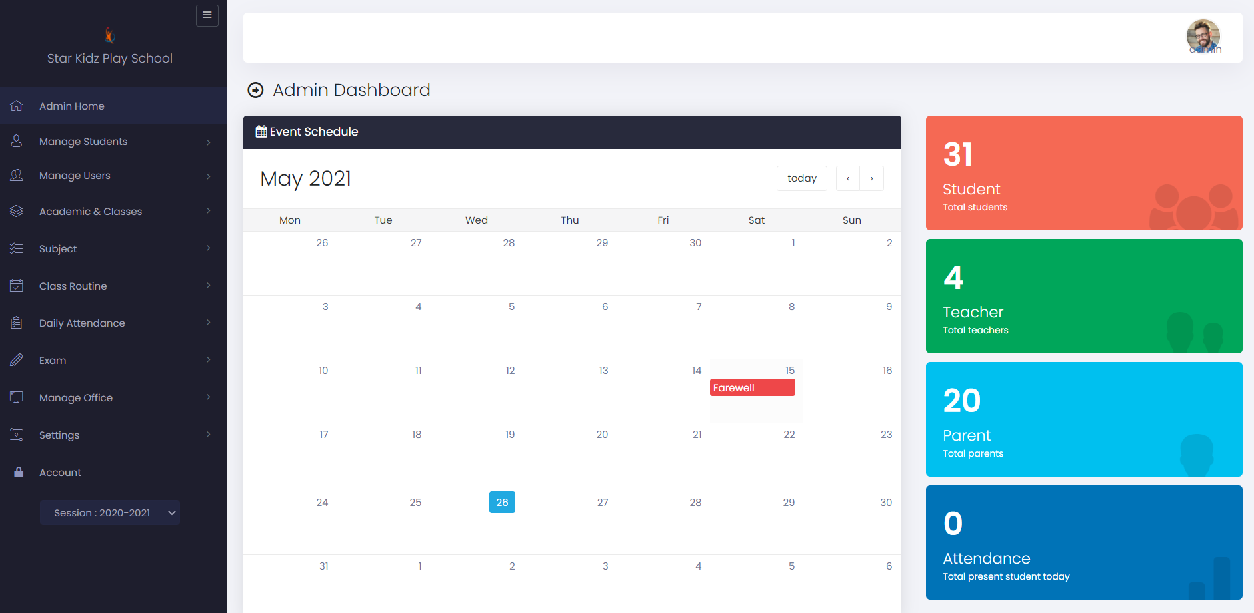
Output for admin
Why Should I Study this course?
Examples
BVRIT HYDERABAD College of Engineering for Women

Slide 13
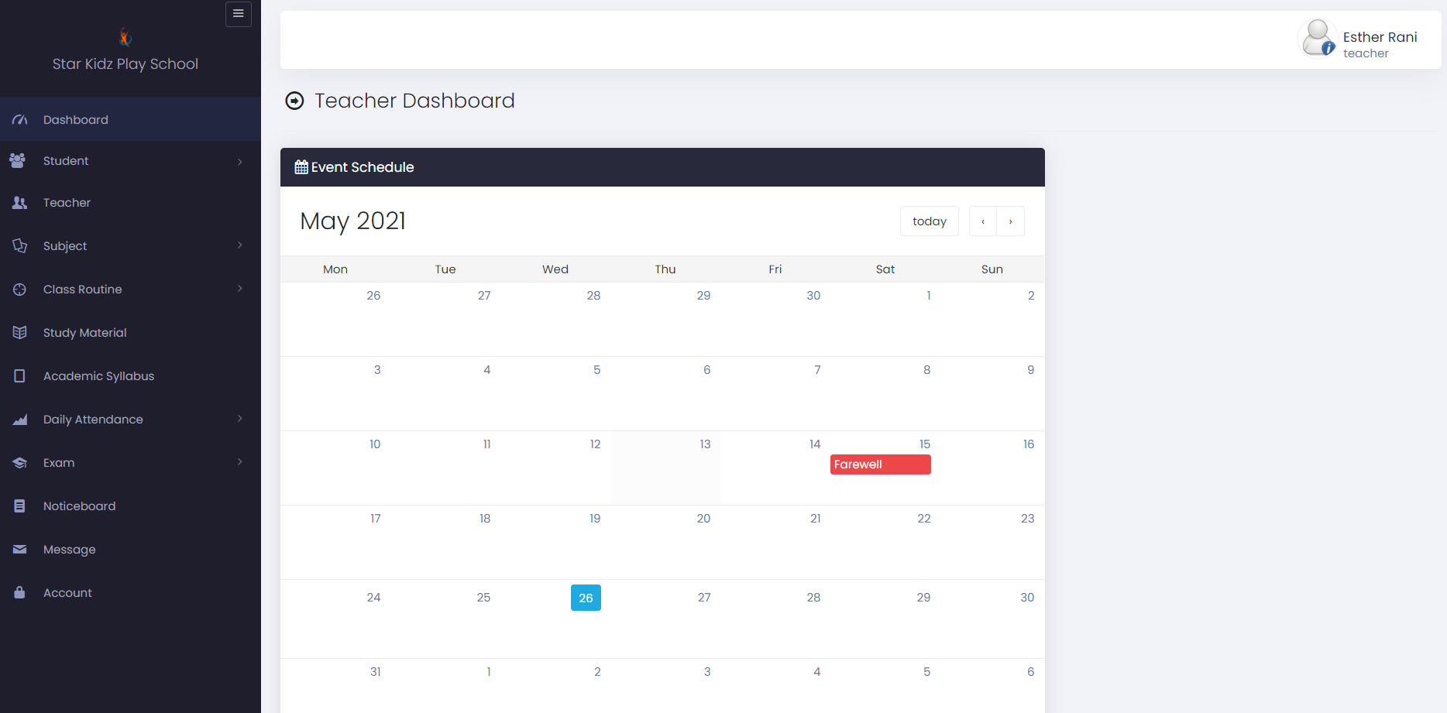
Output for teacher
Why Should I Study this course?
Examples
BVRIT HYDERABAD College of Engineering for Women

Slide 14
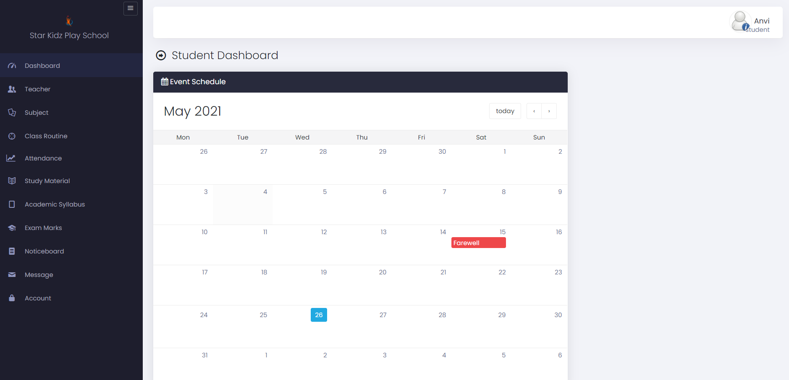
Output for Student
Why Should I Study this course?
Examples
BVRIT HYDERABAD College of Engineering for Women

Slide 15
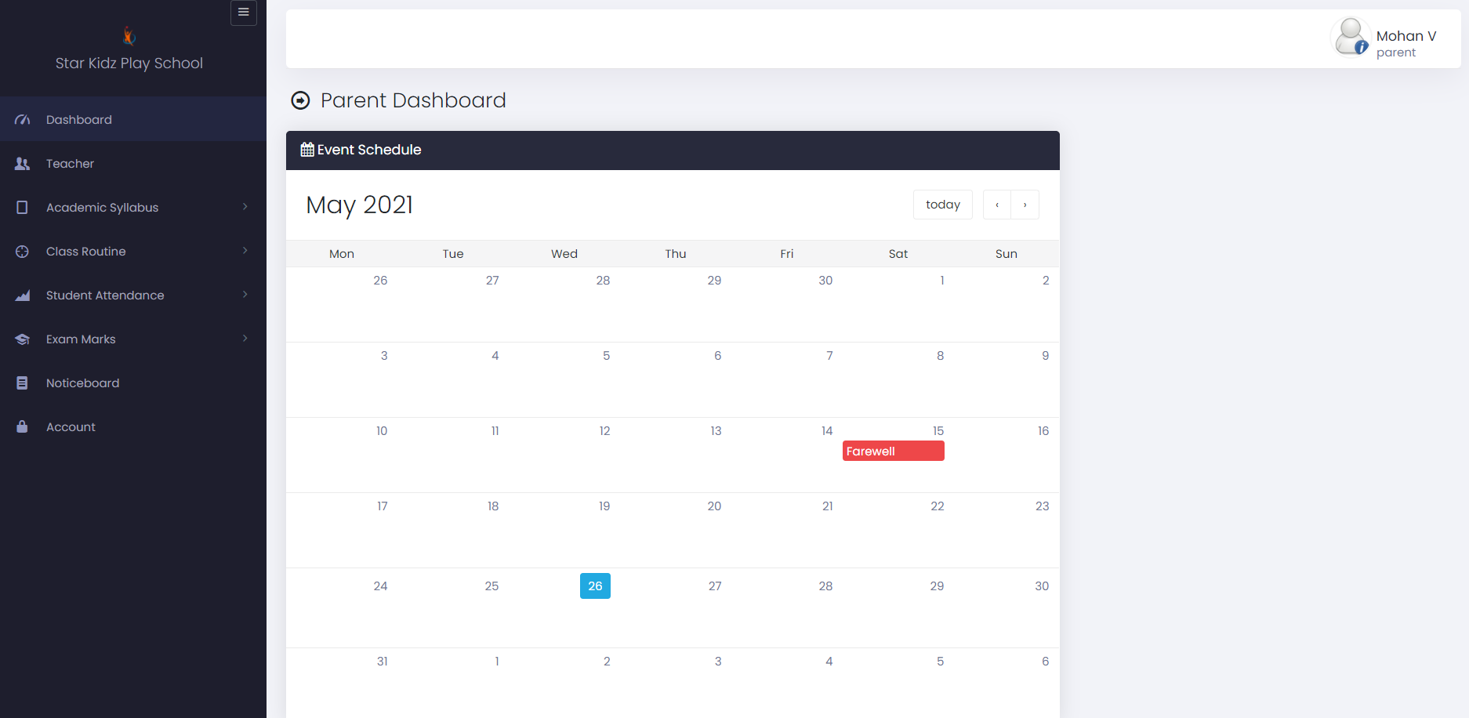
Output for Parent
Why Should I Study this course?
Examples
BVRIT HYDERABAD College of Engineering for Women

Slide 16
References
Why Should I Study this course?
[1] Er. Saurabh Walia, Er. Satinderjit Kaur Gill, “A Framework for Web Based Student Record Management System using PHP”, IJCSMC, Vol. 3, Issue. 8, August 2014.(base paper)
[2] S. R.Bharmagoudar, Geeta R.B and S.G. Totad, “Web based student management system.”, Andra Pradesh, vol.2 June 2013. (base paper)
[3] D. Zhibing Liu, Huixia Wang, Hui Zan “Design and implementation of student information management system.” 2010 International Symposium on intelligence information processing and trusted computing.
[4] M.A.Norasiah and A.Norhayti “Intelligent student information system.”, 4th International conference on telecommunication technology proceedings. Shah Alam, Malaysia, 0-7803-7773-7/03 2013 IEEE
[5] CAI Chang-an, WaNG Qi, “Design and implementation of student information management system based on B/S model”, computer engineering and design, Beijing, 2012.
Examples
BVRIT HYDERABAD College of Engineering for Women

Slide 17
Thank you

